Slide 1
PlayFair Ciphertext Encryption
Submitted by: Submitted to:
Vicky Kumar Ms. Shalini Ma’am (6th Semester) (Assistant Professor)
(CSE Department)

Slide 2
We encrypt a pair of alphabets instead of a single alphabet.
It was used for tactical purposes by British forces in the Second Boer War and in World War I and for the same purpose by the Australians during World War II.

Slide 3
Algorithm : Generate the key Matrix (5×5)
The key square is a 5×5 grid of alphabets (that acts as the key for encrypting the plaintext).
Each of the 25 alphabets must be unique and one letter of the alphabet (usually J) is omitted from the table (as the table can hold only 5x5 alphabets).
If the plaintext contains J, then it is replaced by I.
The initial alphabets in the key square are the unique alphabets of the key in the order in which they appear followed by the remaining letters of the alphabet in order.

Slide 4
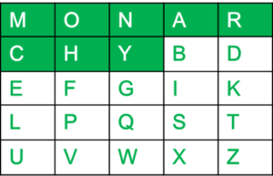
For example:
The key is "monarchy"
Thus the initial entries are...
'm','o','n','a','r','c','h','y'
...followed by remaining characters of
a-z (except 'j') in that order.

Slide 5
Algorithm : encrypt the plain text
The plaintext is split into pairs of two letters (digraphs).
If there is an odd number of letters, then Z is added to the last letter.
PlainText: "instruments"
After Split: 'in' 'st' 'ru' 'me' 'nt' 'sz'

Slide 6
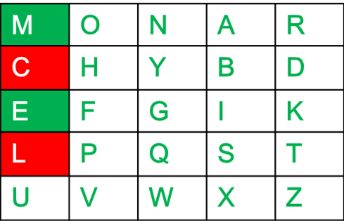
Rules 1st for Encryption
If both the letters are in the same column
----------------------------
Take the letter below each one (going back to the top if at the bottom).
For example:
Diagraph: "me"
Encrypted Text: cl
Encryption:
m -> c
e -> l

Slide 7
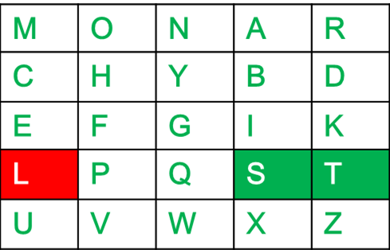
Rules 2nd for Encryption
If both the letters are in the same row
----------------------------
Take the letter to the right of each one (going back to the leftmost if at the rightmost position).
For example:
Diagraph: "st"
Encrypted Text: tl
Encryption:
s -> t
t -> l

Slide 8
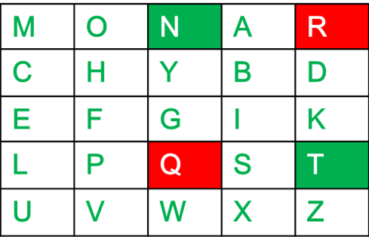
Rules 3rd for Encryption
If neither of the above rules is true
----------------------------
Form a rectangle with the two letters and take the letters on the horizontal opposite corner of the rectangle.
For example:
Diagraph: "nt"
Encrypted Text: rq
Encryption:
n -> r
t -> q

Slide 9
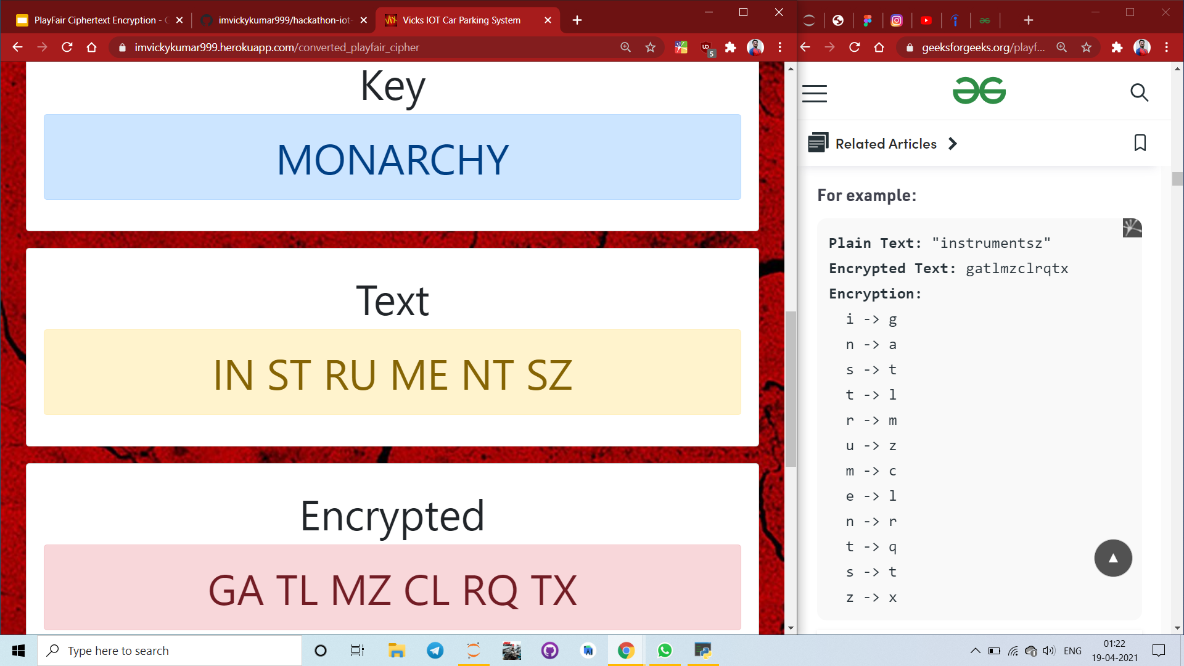
Check Output on Website

